Slide 1
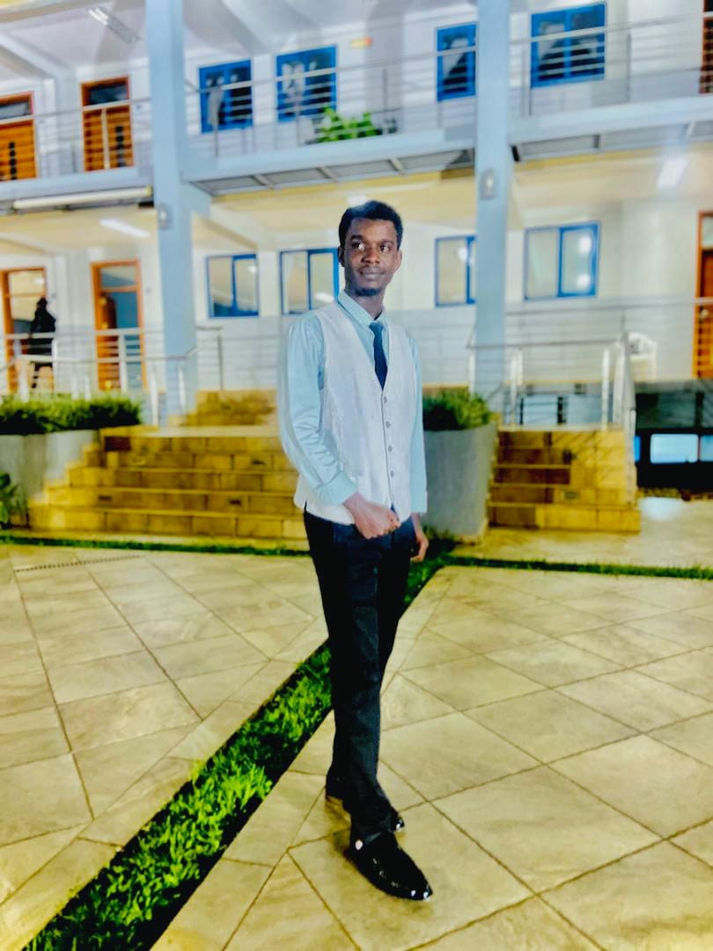
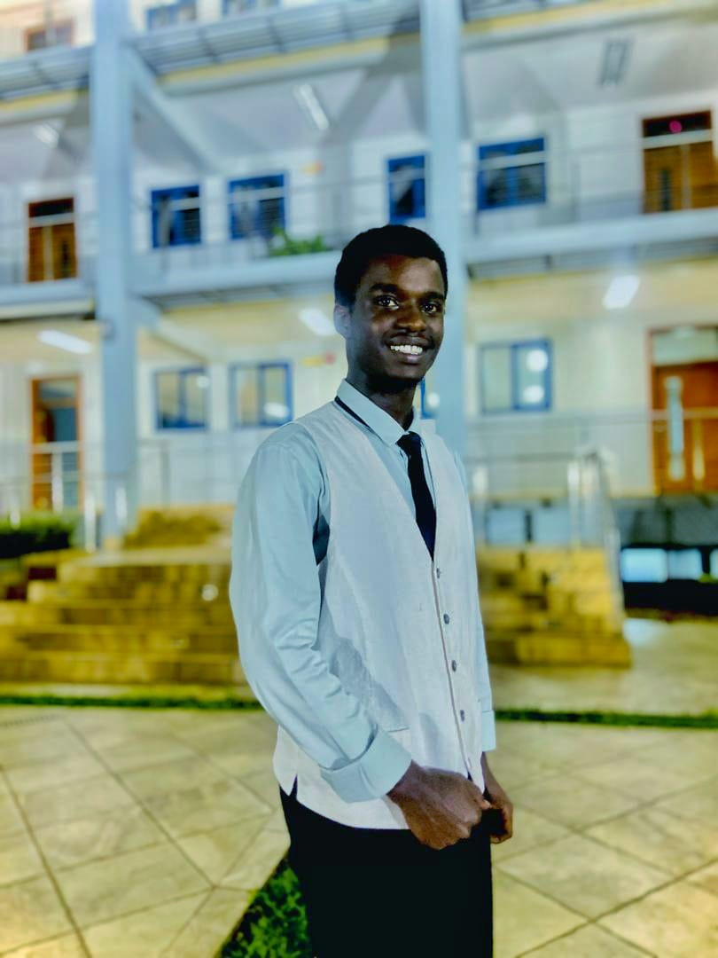
PERSONAL
PROFILE
PERSONAL INFORMATION
NAMES: NIBISHAKA Thoti Pacifique LinkedIn: Specialization: Software Engineer Year: 2nd year Nationality: Rwandan
Use of Digital Information
Expectation to the Course
What They Do Not Know About Me
I frequently use GitHub for version control, SQL databases for data management, and Stack Overflow for troubleshooting and learning.
I aim to deepen my understanding of PL/SQL and enhance my database management skills for developing more efficient back-end solutions.
I can't be afraid to fail. It's the only way I succeed. This keeps me working hard to wards my goals.

